Slide 1
Did You Do Your Homework? Use Case-Driven SIEM Deployments
SIEM Summit 2019

Slide 2
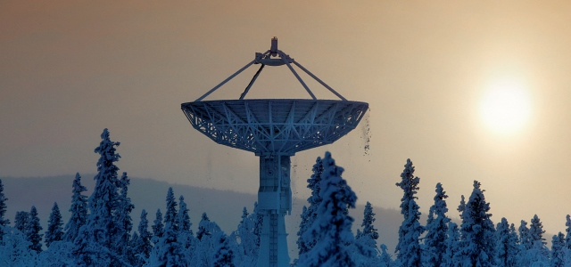



Who am I?
Scott Lynch @PacketEngineer
Security Operations Manager @SSCSpace
Former US Navy EW
Up and coming SANS Instructor SEC555

Slide 3
Did you do your homework?

Slide 4

“If you fail to plan, you are planning to fail.”, Benjamin Franklin or Spiderman….

Slide 5
Importance of Planning
Identify the purpose
Expected Outcome
Timeline
Resources
Importance and Priority
Impact of failing

Slide 6

Define base requirements
Determine the need
What problems are you solving?
Business case
Compliance, Customer requirement
Storage and Log Volumes
Events Per Second (EPS)
Budget
Time

Slide 7

Lessons learned as a guide
Use lessons learned from previous security events
Example: User infects machine with PowerShell malware from an email
Lesson Learned:
A/V did not stop infection and execution
Host logging was limited
Malware succeeded in executing and infection
After Action:
Install Sysmon and collect additional log data
Enable PowerShell Logging
Update A/V policy to detect PowerShell execution
Send logs to centralized logging solution for alerting and monitoring

Slide 8

Requirements we've all heard before
Identify all the threats on my network
Let me when things I don’t want to happen, happen
Let me know when a user clicks on a phishing email
Let me know when a treat actor tries to break into my network

Slide 9

Its complicated…
Log sources are not your only problem
Standards vary, leading to customization or modification
Enrichment may be needed to add value

Slide 10
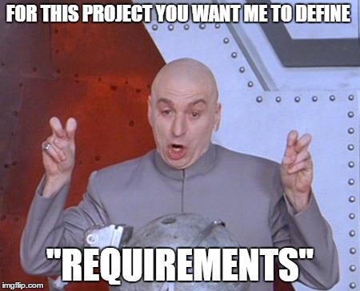
Examples of real requirements
User interface and analyst experience
Correlation
Log source coverage
Dashboards and analyst views
Reporting
Search and query
Escalation, shift and analyst collaboration support
Ability to gradually expand storage on demand
Complete log categorization and normalization for cross-device correlation
New log source integration technology and process: ability to either quickly integrate new log sources or have vendor do it promptly (days to few weeks) upon request

Slide 11
How does my network work?
Simple question with not so simple answer
CIS 1 - Inventory of hardware
CIS 2 - Inventory of software
Network diagrams
Entity relationship diagrams (ERD)

Slide 12
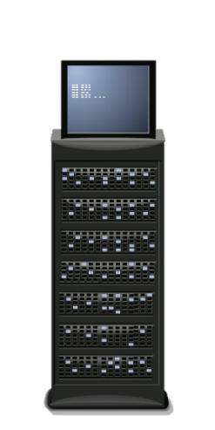



Use case : Unauthorized logins to internet facing asset
External Attacker Box
Victim Machine
Domain Controller
Attacker exploits system and attempts to pivot to DC
2
DC logs failed login attempt
External attacker phishes victim machine
3
1

Slide 13


Expanded Use Case
External Attacker Box
Victim Machine
Domain Controller
1
4
3
2
Firewall logs
Ingres/Egres
Netflow
SMTP Logs
SPAM Filter Logs
Host/Endpoint Logs
DC Logs
Observation
What else?
Security Analyst
Email Server

Slide 14

Write it down!
Requirements
Test plans
Implementation plans
Change control docs
Training
…

Slide 15

Custom SIEM Use Cases/Scenarios
Problem: User may have opened a malicious email attachment
Possible Detections:
Event logs
What Event ID’s?
Sysmon
Additional log detail
Network Traffic
Host or LAN/WAN, Netflow
End Point Protection
A/V or EDR
DNS Queries

Slide 16

Standardization - Sigma
Sigma is a generic and open signature format
The rule format is
flexible
easy to write
applicable to any type of log fil.
The main purpose to provide a structured form shareable with others.
Sigma is for log files what Snort is for network traffic and YARA is for files.
Developed by
Florian Roth @cyb3rops and Thomas Patzke @blubbfiction
https://github.com/Neo23x0/sigma

Slide 17

Testing
Need to validate your use cases
Test case to follow the use case
Document your findings

Slide 18
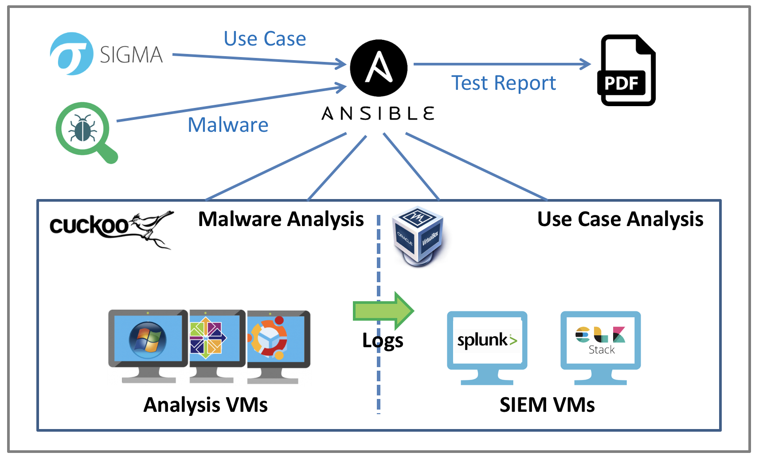
Ypsilon: Automated Use Case Testing
Ypsilon is an Automated Security Use Case Testing Environment using real malware to test SIEM use cases in an closed environment.
Different tools such as Ansible, Cuckoo, VirtualBox, Splunk and ELK are combined to determine the quality of a SIEM use case by testing any number of malware against a SIEM use case.
Finally, a test report is generated giving insight to the quality of an use case.
https://github.com/P4T12ICK/ypsilon

Slide 19
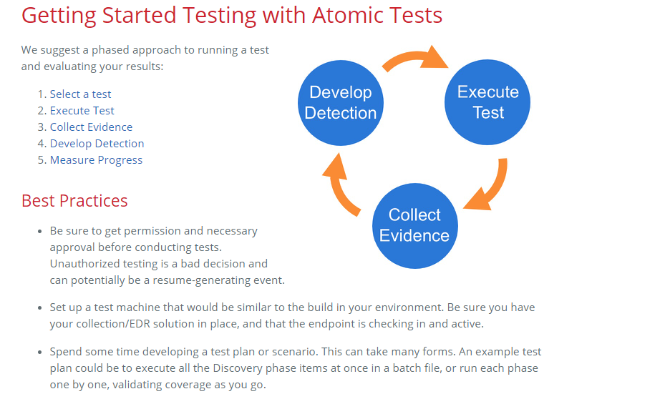

Atomic Red Team
Select a Test
Execute a Test
Collect Evidence
Develop Detection
Measure Progress
https://github.com/redcanaryco/atomic-red-team

Slide 20

Caldera and Brawl
Automated adversary emulation system
BRAWL seeks to create a compromise by creating a system to automatically create an enterprise network inside a cloud environment
https://github.com/mitre/caldera
https://github.com/mitre/brawl-public-game-001

Slide 21
Additional resources
Blue Team handbook: SOC, SIEM and Threat Hunting Use Cases. Notes from the the Field (v1.02), Don Murdoch
Security Information/Event Management Security Development Life Cycle v5 https://www.sans.org/media/score/esa-current.pdf
(NIST) Special Publication (SP) 800-64, Security Considerations in the System Development Life Cycle https://nvlpubs.nist.gov/nistpubs/Legacy/SP/nistspecialpublication800-64r2.pdf
SPECIFYING SYSTEM SECURITY REQUIREMENTS, Paula A. Moore https://csrc.nist.gov/csrc/media/publications/conference-paper/1999/10/21/proceedings-of-the-22nd-nissc-1999/documents/papers/t03.pdf
Red Teaming/Adversary Simulation Toolkit https://github.com/infosecn1nja/Red-Teaming-Toolkit

